Slide 1

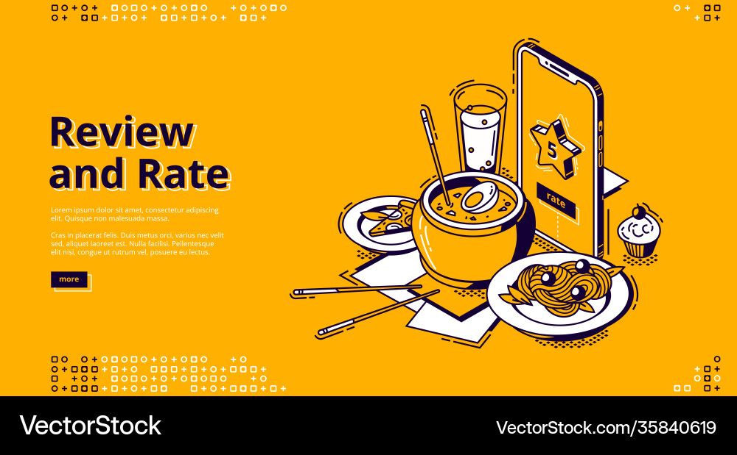

Data Behind the Perfect Cup: Exploring Coffee Shop Trends and Customer Preferences
Does Product Pricing Correlate with Customer Ratings or Reviews?
How do customer reviews reflect overall, service, and price sentiment distributions, and what key insights can we derive from these sentiments?
Lavenya Mohansundaram

Slide 2
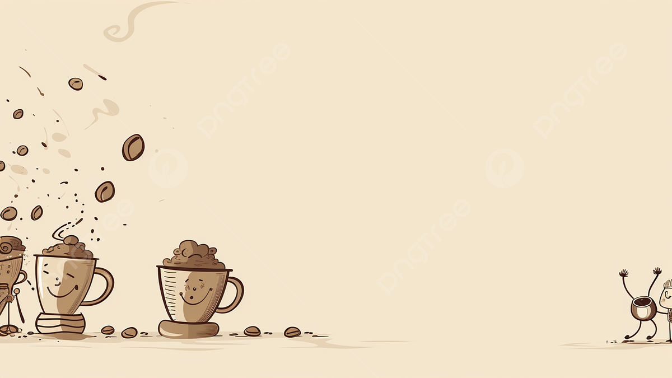
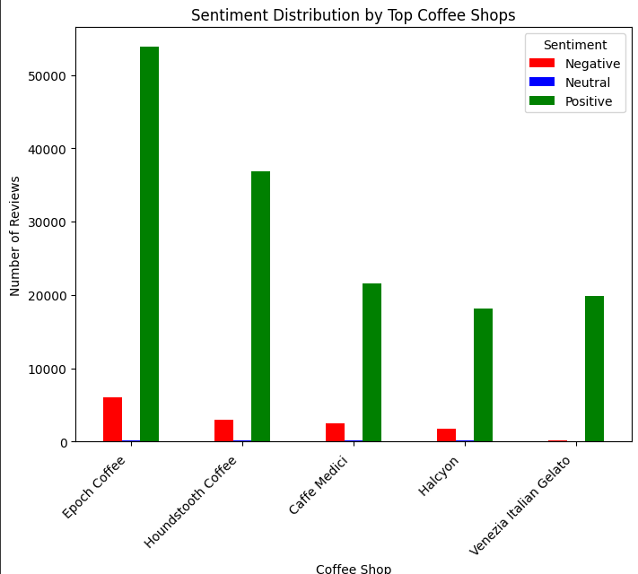
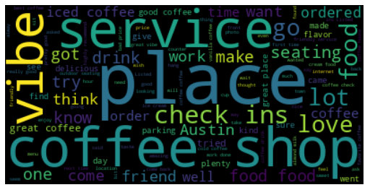
Sentiment Analysis – Customer Review
Overall Sentiment Distribution
Positive Sentiment: 548,831 reviews (dominates the overall sentiment)
Negative Sentiment: 40,393 reviews
Neutral Sentiment: 5,551 reviews
Most positive reviews indicate that customers generally have favorable experiences at these coffee shops.

Slide 3
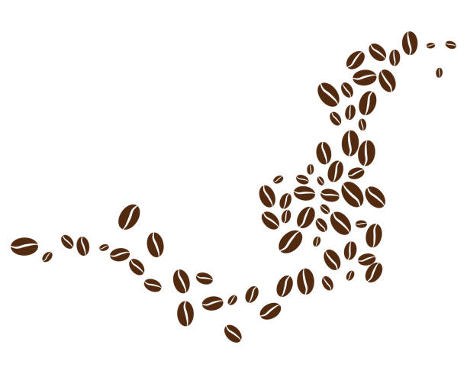
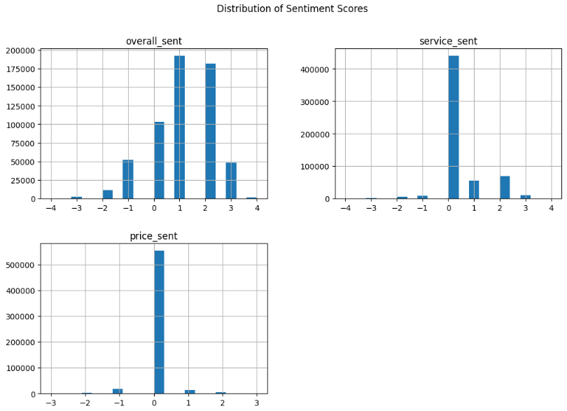



Distribution of sentiment scores across four key aspects: overall sentiment, service sentiment, & price sentiment
Positive Sentiment: overall_sent leans towards positive values, indicating customer satisfaction in these areas.
Neutral Sentiment: service_sent and price_sent are mostly centered around 0, suggesting that these factors do not significantly impact customers' feelings.
These insights can help prioritize improvements in service quality while maintaining high coffee quality to enhance customer satisfaction.

Slide 4

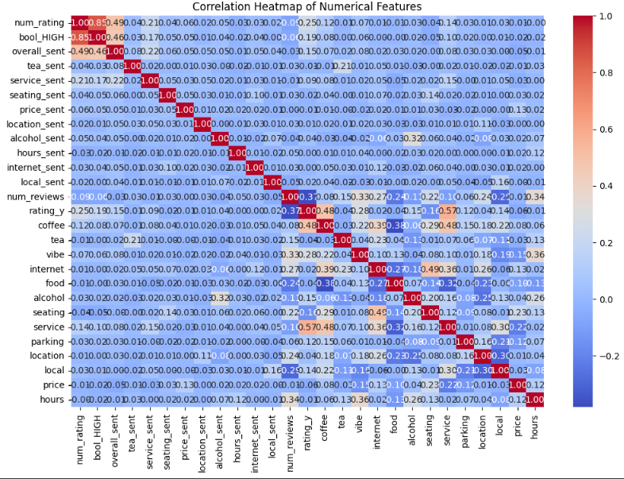
Correlation Between Price and Ratings/Reviews
Focus on High-Impact Factors: If coffee, vibe, or service correlate strongly with ratings, these are areas to enhance.
Pricing Strategy: Given that price may not correlate strongly with rating_y or num_reviews, coffee shops should ensure pricing reflects value without expecting it to significantly influence ratings.
Notes:
Conclusion:
Price is not a major factor in determining customer ratings or the number of reviews a coffee shop receives.
This insight suggests that coffee shops should focus more on quality, service, and ambiance rather than adjusting prices to influence customer ratings or review volume.
These findings provide valuable guidance for coffee shops: investing in quality and customer experience will significantly impact customer satisfaction and engagement more than changing prices.

Slide 5
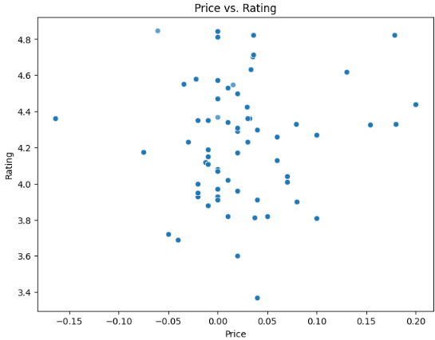
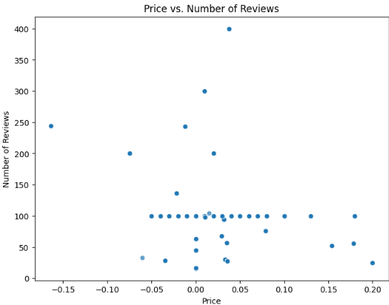

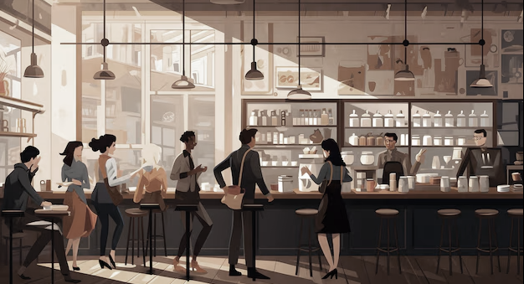
Does Product Pricing Correlate with Customer Ratings or Reviews?
Notes:
Scatter Plots to visually explore: Price vs. Rating: Is there a trend indicating higher prices lead to better ratings?
Price vs. Number of Reviews: Do higher-priced products receive more or fewer reviews?
Correlation Analysis Results:
Correlation between Price and Rating: -0.05
Correlation between Price and Number of Reviews: -0.006
These values are very close to zero, indicating an extremely weak negative correlation between price and both rating_y and num_reviews.
Interpretation: This means that price has almost no impact on customer ratings or the number of reviews a coffee shop receives. Customers are not rating based on price alone, nor is pricing affecting their likelihood to leave a review.
The lack of a trend in the scatter plot reinforces the correlation analysis results, showing that price does not significantly impact ratings and reviews. Whether the price is high, low, or around zero, customer ratings/ reviews seem to vary independently.

